Slide 1

Part 7
Database Access Through the Web

Slide 2
Contents
13.1 Relational databases
13.2 Structured Query Language(SQL)
13.3 Architectures for database access
13.4 The MySQL database
13.5 Database access with PHP and MySQL

Slide 3
13.1 Relational Databases
A database stores data in a way allowing
Efficient changes (additions, modifications and deletions),
Efficient searching.

Slide 4
14.1 Relational Databases
The relational model is currently the most popular model.
Data is stored in many tables.
Table columns are named.
Each row of a table contains a value for each column, though some values may be missing.
Rows are referred to as entities.
The primary key is one or more columns in a table whose values uniquely identify each row.

Slide 5
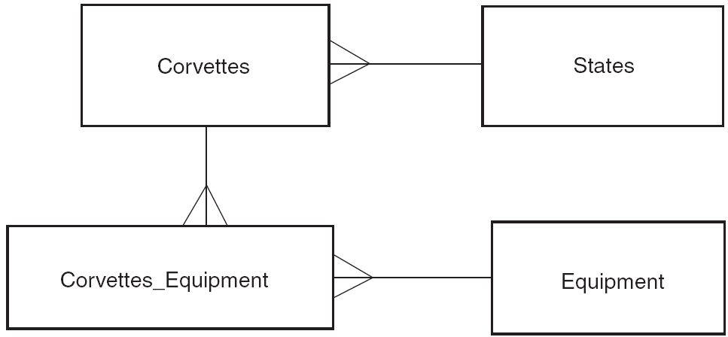
13.1 Logical Data Model for Corvettes DB

Slide 6


Corvettes

Slide 7
13.1 Relational Databases
Example, Corvettes table
Primary key is an index number.
Each row represents a different vehicle.
Columns are important characteristics of the vehicles.
Figure 13.3

Slide 8
13.1 Relational Databases
Each state can be associated with several cars.
Each state could have important data, besides the name.
A separate States table is created with a primary key.
Each entity in the Corvettes table refers to the States .
That way, changes in information about a state would not have to be repeated on each line of the Corvettes table.

Slide 9
13.1 Relational Databases
Each type of equipment could appear in many cars, and each car could have many types of equipment.
A table Equipment describing equipment is set up.
A table Corvettes_Equipment giving the Corvettes and Equpment relation is set up.
This is specified by pairs of ids: Corvette-id and Equipment-id.

Slide 10
13.2 Structured Query Language
SQL is a standardized language for manipulating and querying relational databases.
Although relational databases support SQL, there may be some minor or significant differences in the implementations for different DBMS such as Oracle, SQL Server, Sybase, DB2.
SQL is non-procedure language.

Slide 11
13.2 Structured Query Language
SQL reserved words are not case sensitive
However, some systems may treat names such as column names as case sensitive.
Single quotes ‘ are used for literal strings.

Slide 12
13.2 The CREATE TABLE Command
Create a table with specified columns, each column having a specified type of data and satisfying certain constraints.
Syntax
CREATE TABLE table_name(
column_name_1 data_type constraints,
...
column_name_n data_type constraints);
Common types: integer, real, double, char(length)

Slide 13
13.2 Create Table Constraints
The constraint not null causes an error to be raised if a row is inserted in which the corresponding column does not have a value.
The primary key constraint causes an error to be raised if a row is inserted in which the corresponding column has a value that equals the value in another row.
This can be applied to a group of several columns if the primary key is multi-column.
The foreign key constraints use for the referring to the column in another table.

Slide 14
13.2 The CREATE TABLE Example
create database hjydb;
use hjydb;
create table states(
state_id integer not null primary key,
state char(20)
);

Slide 15
13.2 The CREATE TABLE Example
create table v(
v_id integer(4) not null primary key,
body_style char(20),
miles double,
year integer,
state integer,
foreign key(state)
references states(state_id));

Slide 16
13.2.2 The INSERT Command
Inserts a new row into a table
Syntax
INSERT INTO table_name
(column_name_1, ..., column_name_n)
VALUES (value_1, ..., value_n);
The values provided will be placed into corresponding columns.
Columns not named will receive no value.
This will cause an error if the column was created with a not null constraint

Slide 17
13.2 The INSERT Command Example
insert into states(state_id, state) values(1,’Florida’);
insert into v values(1,'couple',32.3,1976,1);

Slide 18
13.2 The SELECT Command
Used to query databases
The command returns a result, a virtual table.
SELECT column-names FROM table-names [WHERE condition];
The resultant table has columns as named.
Rows are derived from the table named.
The WHERE clause is optional.
The WHERE clause specifies constraints on the rows being selected.
If * is used for the column names, all columns are selected.

Slide 19
13.2 The SELECT Command Example
select v_id, body_style from v;
select body_style, miles from v where v_id=1;

Slide 20
13.2 Joins
Task: list corvettes that have CD players
This involves three tables: Corvettes, Equipment, Corvettes_Equipment
A virtual table is constructed with combinations of rows from the two tables Corvettes and Equipment: a join of the three tables
The WHERE clause specifies which rows of the join are to be retained in the result

Slide 21
13.2 A Query Using a Join
SELECT Corvettes.Vette_id, Corvettes.Body_style,
Corvettes.Miles, Corvettes.Year, Corvettes.State,
Equipment.Equip
FROM Corvettes, Equipment,Corvettes_Equipment
WHERE
Corvettes.Vette_id = Corvettes_Equipment.Vette_id
AND Corvettes_Equipment.Equip = Equipment.Equip_id
AND Equipment.Equip = 'CD';

Slide 22
13.2 The UPDATE Command
Changes values in an existing row or some rows
Syntax
UPDATE table_name
SET column_name_1 = value_1,
...
column_name_n = value_n
WHERE column_name = value
The WHERE clause identifies the rows to be updated.

Slide 23
13.2 The UPDATE Command
update states set state=‘New York’ where state_id=1;

Slide 24
13.2 The DELETE Command
Removes one or more rows
Syntax
DELETE FROM table_name
WHERE column_name = value;
The WHERE clause determines which rows are deleted

Slide 25
13.2 The DELETE Command
Delete from states where state_id=1;

Slide 26
13.2 The DROP Command
Remove a table or database from the system
A database system usually has several databases within it, and collections of tables in each database.
Syntax
DROP (TABLE|DATABASE)[IF EXISTS] name;
The IF EXISTS clause may be included to prevent an error indication if the table or database doesn’t exist.

Slide 27
13.3 Client/Server Database Architecture
Two-tier architecture
Client connects to the database to get information.
Client performs computations and user interactions.
Problems with two-tier
Servers getting smaller so client software getting more complex
Keeping clients up to date becomes difficult.

Slide 28
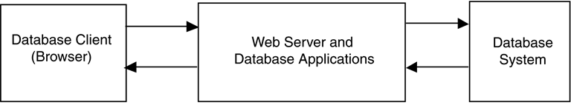
13.3 Client/Server Database Architecture
Three-tier architecture
Web server with applications sits between a browser and the database system.
The web server accesses the database, carries out computations and deals with user interactions.

Slide 29
13.3 Microsoft Access Architectrue
Open Database Connectivity (ODBC)
An application programming interface (API) provides services to interact with a database
One service is to submit SQL to the database system and to return results
An ODBC driver manager, on the client, chooses the proper interface for a particular database

Slide 30
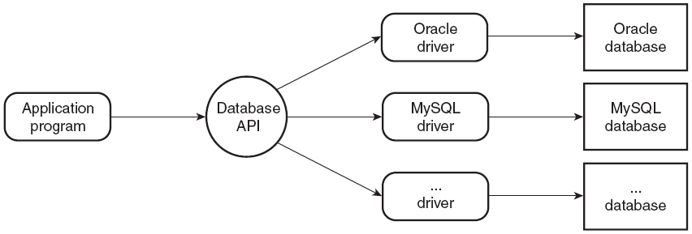
13.3 Database Access Architecture

Slide 31
13.3 PHP and Database Access
There are modules available in PHP to access numerous different database systems

Slide 32
13.4 The MySQL Database System
The first step to use MySQL is logging into the MySQL system, which is done with the following command.
mysql [-h host] [-u username] [database_name] [-p]
The second step is to create a new database.
create database cars;
The third step is to specify which database to be used.
use cars;

Slide 33
13.4 The MySQL Database System
Show how many databases are there on the system
Syntax:
show databases;
Show how many table there are in a specific database
Syntax:
show tables;
Show the schema of table
Syntax
desc v;

Slide 34
13.5 Database access with PHP and MySQL
PHP access to Mysql is achieved with two documents.
One is to collect user request (.html).
The other is used to process the request and return the HTML document (.php).

Slide 35
13.5.2 Connecting to MySQL
The mysqli_connect() function connects a script to a MySQL server and selects a database
It accepts four parameters.
First parameter is MySQL server host
Second parameter is the MySQL username
Third parameter is the password, the default is blank
Fourth parameter is the name of the selected database
Example: connect.php

Slide 36
13.5.2 Connecting to MySQL
The mysqli_close() function accepts the handle of the connection.
Example: connect.php

Slide 37
13.5.2 Connecting to MySQL
<?php
$db = mysqli_connect('localhost','root','','enweb');
if (!$db) {
die('Could not connect: ' . mysql_error());
}
echo 'Connected successfully <br/>';
mysqli_close($db);
echo 'I have closed the database‘;
?>

Slide 38
13.5.3 Requesting MySQL Operations
The mysqli_query function takes two parameters,
The first is the return value from the mysqli_connect
The second is SQL
Returns a result object
Example:
$query=“select * from v”;
$result=mysql_query($db,$query);

Slide 39
13.5.3 Requesting MySQL Operations
Functions that apply to the result object
mysqli_num_rows returns number of rows in the result.
mysqli_num_fields returns the number of fields (columns) in the result.
mysqli_fetch_assoc returns an array with the next row of results. The keys are the column names and the values are the values of those column fields.

Slide 40
13.6.3 Requesting MySQL Operations
Example fetch.php
……
$num_rows=mysqli_num_rows($result);
$num_fields=mysqli_num_fields($result);
$row=mysqli_fetch_assoc($result);
$keys=array_keys($row);
for($index=0;$index<$num_fields;$index++)
print $keys[$index].' ';
print '<br/>';
……

Slide 41
13.6.3 Requesting MySQL Operations
Example fetch.php
……
for ($row_num = 0; $row_num < $num_rows; $row_num++)
{
$values=array_values($row);
for($index=0;$index<$num_fields;$index++)
print $values[$index].' ';
print '<br/>';
$row=mysqli_fetch_assoc($result);
}
……

Slide 42
13.6.3 Requesting MySQL Operations
The keys are the column names.
Example:
$row=mysqli_fetch_assoc($result);
$keys=array_keys($row);
for($index=0;$index<$num_fields;$index++)
print $keys[$index].' ';

Slide 43
13.6.3 Requesting MySQL Operations
Each array contains each field value indexed by position
Example:
$values=array_values($row);
for($index=0;$index<$num_fields;$index++)
print $values[$index].' ';

Slide 44
13.6 PHP/MySQL Example
The example with carsdata.html and access_cars.php allows users to submit SQL commands that are executed against the enweb1 database

